Slide 1
Philosophy of Science
Francesco Di Iorio
francedi.iorio@gmail.com
185 5166 1135

Slide 2
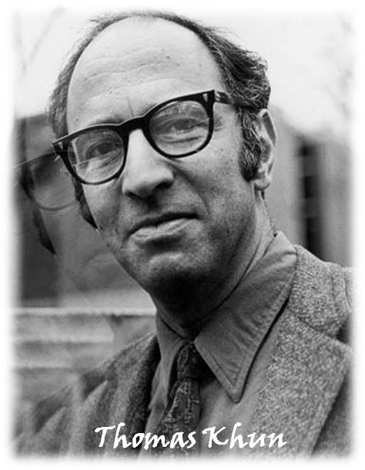
Thomas Khun (1922-1996)

Slide 3
A key feature of Kuhn’s theory is the emphasis placed on the revolutionary character of scientific progress
The history of science is characterized by revolutions
A revolution involves the abandonment of one theoretical structure (conceptual framework) and its replacement by another, incompatible one
Another important feature of science is its sociological dimension
An important role is played by the sociological characteristics of scientific communities

Slide 4
Kuhn's picture of the way a science progresses can be summarised by the following scheme:
Pre-science
Normal science (a single paradigm becomes dominant)
Crisis
Revolution
New normal science
New crisis
Paradigms: Newtonian mechanics, wave optics, analytical chemistry…

Slide 5
The existence of a (dominant) paradigm capable of supporting a normal science tradition is the characteristic that distinguishes science from non-science, according to Kuhn
Sociology lacks a paradigm and consequently cannot be regarded as science
Kuhn portrays normal science as a puzzle-solving activity governed by the rules of a paradigm

Slide 6
Normal scientists must presuppose that a paradigm provides the means for the solution of the puzzles posed within it
A failure to solve a puzzle is seen as a failure of the scientist rather than as an inadequacy of the paradigm
Puzzles that resist solution are seen as anomalies rather than as falsifications of a paradigm
Kuhn recognizes that all paradigms will contain some anomalies (for example the Copernican theory and the apparent size of Venus) and rejects all brands of falsificationism

Slide 7
According to Kuhn, an analysis of the characteristics of a crisis period in science demands the competence of the psychologist as much as that of the historian
When anomalies come to be seen as posing serious problems for a paradigm, a period of "pronounced professional insecurity" sets in
When the proponents lose their confidence in the paradigm, the time is ripe for revolution
The seriousness of a crisis deepens when a rival paradigm makes its appearance
Kuhn: "the new paradigm, or a sufficient hint to permit later articulation, emerges all at once, sometimes in the middle of the night, in the mind of a man deeply immersed in crisis".
The new paradigm will be very different from and incompatible with the old one.

Slide 8
The new paradigm will be very different from and incompatible with the old one
Each paradigm will regard the world as being made up of different kinds of things (e.g. Aristotelian universe/later theories of the universe, phlogiston theory/Lavoisier chemistry)
Rival paradigms will regard different kinds of questions as legitimate or meaningful (questions about the weight of phlogiston were important for phlogiston theorists and vacuous for Lavoisier)
As well as posing different kinds of questions, paradigms will involve different and incompatible standards (uncaused motion was nonsense for Aristotle and axiomatic for Newton)
Proponents of rival paradigms are "living in different worlds"

Slide 9
The adoption on the part of individual scientists of a new incompatible paradigm is likened by Kuhn to a "religious conversion“
There will be no purely logical argument that demonstrates the superiority of one paradigm over another
Relativism (no objective truth)

